Slide 1
STATISTICAL STUDIES IN THE PHARMACEUTICAL INDUSTRY

Slide 2
contents
1.İNTRODUCTİON
2.ARTIFICIAL NEURAL NETWORKS (ANN)
3.THE RESPONSE SURFACE METHOD
4.MATERIALS AND METHODS
5.RESULT AND DISCUSSION
6.CONCLUSİON
7.REFERENCES

Slide 3
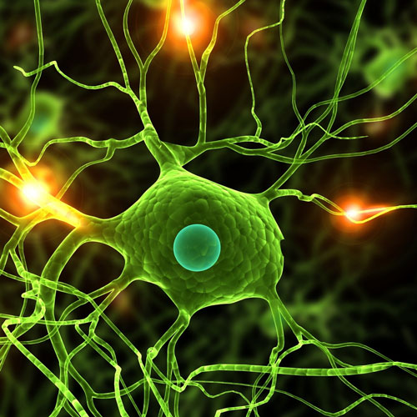
1.introduction
Today, with the developing technology, both time and cost are becoming increasingly valuable. For this reason, it is aimed to find results close to reality by saving time and cost with statistical methods. In this study, Two statistical methods called "Artificial Neural Networks (ANN)" in the Matlab programme and "Response Surface Method (RSM)" in the Minitab package programme were used. It was determined how close the results obtained in the programme are to the results found in the laboratory experiment.

Slide 4
2.Artificial Neural Networks (ANN)
"Artificial Neural Networks (ANN)", which was discovered by being inspired by the human brain, is a computer system and prediction method that serves this purpose in addition to the fact that it performs many abilities such as producing, designing and predicting information just like our brain without any help [1]. Inputs are introduced to the network and then output variables are given in response to the inputs. The network is trained by learning the relationship between input and output. [2].

Slide 5
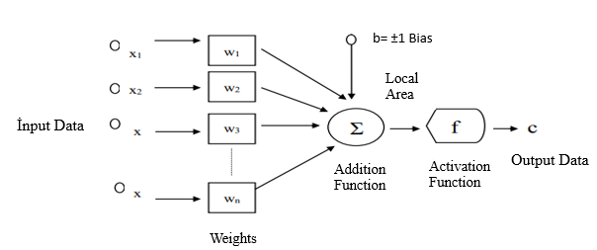
The artificial nerve cell consists of five parts;
Input variables
Weights
Collection function
Activation function
Output variables [3]
Figure 1. Working Principle of Artificial Neural Network [3]

Slide 6
3.THE RESPONSE SURFACE METHOD
The Response Surface Method is a technique that combines mathematics and statistics, which is used in analysis and modeling in some applications where the answers sought are affected by different variables and these answers are aimed to reach optimized conditions. The response surface method, which is used in industry and many other fields, is frequently used in scientific research as it enables us to reach the most appropriate answer with fewer experiments [4].
The response surface method consists of 3 stages: model validation, mathematical modeling and design of experiments[5].

Slide 7
4.Materials and Methods
In this study, the data from the article "Synthesis and characterization of hydrogels based on poly(2-hydroxyethyl methacrylate) for drug delivery under UV irradiation" were used within the scope of statistical study in the pharmaceutical industry. The results [6] were predicted by Artificial Neural Network (ANN) and Response Surface Method (RSM). For Artificial Neural Networks (ANN), Matlab programme R2018b version Neural Network Toolbox was used. For the Response Surface Method (RSM), the Minitab package programme Design Of Experiment (DOE) was used. The prediction results were statistically compared with the experimental results.

Slide 8
5.Result and Discussion
Firstly, predictions were made with Artificial Neural Network and compared with the results in the paper. MATLAB programme was used in the development of the ANN model. With the help of the codes written in the MATLAB programme, the data set was introduced to the network and training was performed. The most appropriate network architecture was determined and the model was created. In the study, a feed-forward network structure was used to predict the drug release rate of the hydrogel. The first step of the prediction process in artificial neural networks starts with the selection of input, output and test data. Input data consists of 3 columns as Irg 651, Irg 184, Irg 2959. The output data are synthesized hydrogels.

Slide 9
In the table given above, separate predictions were made in Artificial Neural Networks for pH 1.2 in the time period from 10 minutes to 360 minutes, and the most efficient result was obtained for 360 minutes. The prediction study at pH 1.2 at 360 minutes is shown in the image below. The data were normalized before being introduced to the network.The normalisation process is applied to increase model success. Firstly, the data were transferred to the Matlab programme. Input variables are assigned to the input section, output variables are assigned to the output section and variables to be tested are assigned to the test section.

Slide 10
Figure 3: Structure of ANN
Figure 2: Data transfer screen in ANN
The training for the test data in ANN was completed and the prediction processes were performed and the results are as follows.

Slide 11
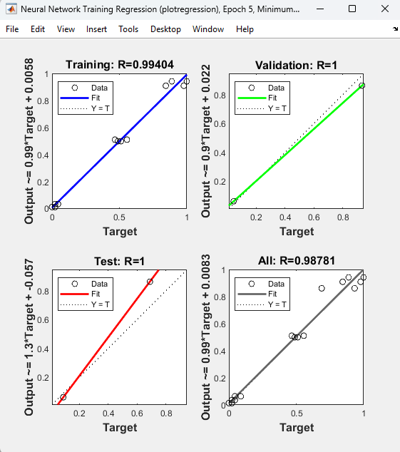
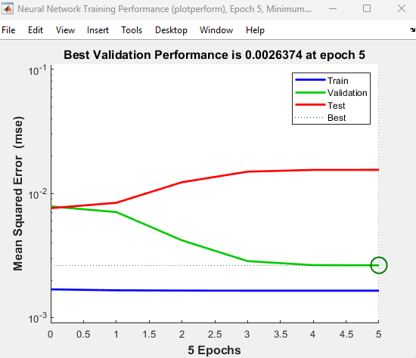
Figure 5. ANN training performance
Figure 4. Regression graph in ANN

Slide 12
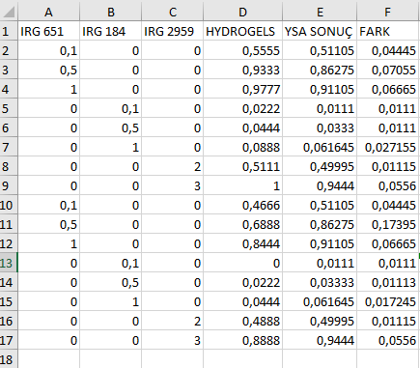
Figure 6: ANN result screen
Table 1: ANN training result screen

Slide 13
The regression equation resulting from the experimental result values and the results generated by the Artificial Neural Network is as follows
Figure 7. Release graph of predicted values and actual values
After the artificial neural network study, the study with the Minitab response surface method (RSM) is as follows. As a first step, the Minitab programme is opened, central composite is selected as the design type from the create response surface design option, the number of factors is selected as 3 for our 3 variables[8] and a design is created.After selecting the central composite design type, input and output variables are assigned.

Slide 14
Figure 8. Data transfer screen in Minitab
Input and output variables are entered separately.

Slide 15
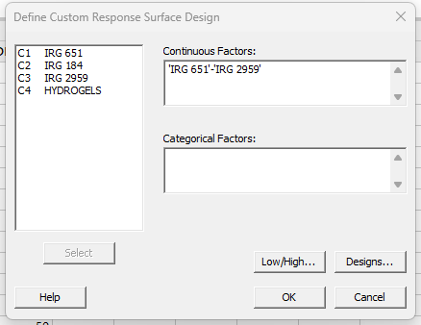
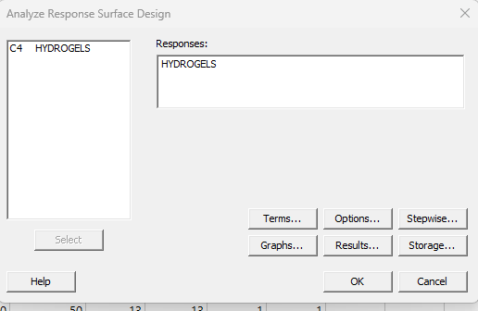
Figure 9. Entering input variables Figure Figure 10. Entering output variable

Slide 16
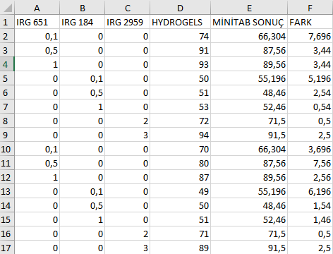
Figure 11. R-value results
Figure 12. Equation found as a result of the analysis
Table 2. Analysis results

Slide 17
The regression equation resulting from the experimental result values and the results generated by the Response Surface Method (RSM) is as follows.
Figure 13. Release graph of predicted values and actual values

Slide 18
6.Conclusion
In the article "Synthesis and characterization of hydrogels based on poly(2-hydroxyethyl methacrylate) for drug delivery under UV irradiation"[8], ANN gave the closest result to the data obtained as a result of the experimental study. The values between outputs and targets are very close to 1. The correlation values of the model are 0.99404 for training, 1 for validation and 1 for testing. The overall correlation coefficient of the data set is 0.98781. The fact that the values are close to 1 for all data shows that the data obtained with ANN training and the real data are compatible with each other. Correlation coefficient values close to 1 means that the model is successful.

Slide 19
Correlation coefficient values close to 1 means that the model is successful. As the mean squared error approaches zero, it means that better results are produced, that is, it can be said that the error is lower and more successful results are obtained. The lowest MSE value for the validation set was 0.0026374. This result again shows that the model is successful. When the Minitab analysis reports are examined, it is seen that the regression equation is significant at a 5% significance level (P= 0.000<α=0.05) R² = 94.53%. When the results of Artificial Neural Networks training and Minitab analysis are graphed separately with experimental values, R² value is 0,9728 for ANN and 0,9453 for RSM. In this way, the results found in the programme were verified. Based on all these, the R² value obtained in the Artificial Neural Network prediction was higher than the Response Surface Method. In this case, it is possible to prefer Artificial Neural Networks in cases where regression analysis assumptions are not met and the analysis cannot be performed.

Slide 20
7.references
[1]. Erdoğan, E., & Özyürek, H. (2012). Price Forecasting with Artificial Neural Networks. Journal of Social and Human Sciences, 4(1), 85-92.
[2]. Yavuz, S., & Deveci, M. (2012). The effect of statistical normalization techniques on artificial neural network performance. Erciyes University Journal of Faculty of Economics and Administrative Sciences, (40), 167-187.
[3]. Damla, Y., Temiz, T., & Keskin, E. (2020). Estimation of Water Level Using Artificial Neural Network: Yalova Gökçe Dam Example. Kırklareli University Journal of Engineering and Science, 6(1), 32-49
[4]. Ateş, Ç., Bayraktar, B. and Bilen, M. (2018). Determination of the Optimum Conditions of a Boron Factory Wastewater Chemical Treatment Process by Response Surface Method. Gazi University Journal of Faculty of Engineering and Architecture, 33(1).
[5]. Albayrak, S. Optimisation of Noise Levels in Machine Tools by Response Surface Method
[6]. [Senol, S., & Akyol, E. (2018). Synthesis and characterization of hydrogels based on poly (2-hydroxyethyl methacrylate) for drug delivery under UV irradiation. Journal of Materials Science, 53, 14953-14963

Slide 21
THANK YOU…

