Slide 1




CANKIRI KARATEKİN UNIVERSITY
Science Faculty
Chemistry Department
Mustafa Al-yasiri
"Synthesis of Imidazoline Derivatives for
Anti-corrosion Efficiency"
By: Mustafa Salih Mahdi
Advisor : Prof. Dr. Volkan EYÜPOĞLU
Co-Advisor : Asst. Prof. Dr. Usama Ali MUHSEN

Slide 2
1.INTRODUCTION
Any cyclic organic compound containing N, O, or S as a substitute for one or more of a single cyclic carbon atom is called a heterocyclic compound. The rings are either non-aromatic rings or simple aromatic rings. Some examples are imidazole (C₃H₄N₂), pyridine (C5H5N), dioxane (C4H8O2) and pyrimidine (C4H4N2) as shown below (Bharti 2011). Imidazole is a five-membered aromatic heterocycle containing two nitrogen atoms. It exhibits resonance due to the delocalization of electrons within the ring (Bharti 2011). In imidazole, the lone pair of electrons on each nitrogen atom can delocalize into the π system of the ring, leading to resonance stabilization. This electron delocalization occurs through the formation of a π bond between the nitrogen atoms and the adjacent carbon atoms in the ring. As a result, the electrons are shared between multiple atoms, creating resonance structures (John and Joule 2010). The resonance structures of imidazole show that the electrons are not localized on specific atoms but are spread out over the entire ring system. This delocalization of electrons enhances the stability of the molecule. It also influences the reactivity of imidazole, making it more nucleophilic and capable of participating in various chemical reactions (John and Joule 2010).
Resonance in Imidazoles (Hazim 2019)
Imidazoline is a class of heterocycles formally derived from imidazoles by the reduction of one of the two double bonds. Three isomers are known, 2-imidazolines, 3-imidazolines, and 4-imidazolines. The 2-imidazolines and 3-imidazolines contain an imine centre, whereas the 4-imidazolines contain an alkene group. The 2-Imidazoline group occurs in several drugs and it is one of the heterogeneous organic compounds used in many pharmaceutical, petroleum and other industries. This thesis focuses on the Synthesis of imidazolinone derivatives using environmentally friendly methods in reducing corrosion in crude oil pipes or other equipment, which causes gas leaks and oil leaks. Imidazoline compound is the most important injected into crude oil in insulation plants to reduce corrosion. Many companies produce imidazoline However, most of the preparation methods used are harmful to the environment and hazardous to humans, particularly those involved in the synthesis of imidazoline.
Iraq crude oil is one of the acidic substances that cause the corrosion of pipes and other equipment. In such a corrosion, we inject imidazoline into the crude oil. Corrosion is one of the recurrent problems during crude Oil extraction and one of the persistent problems that has not been finally disposed of. This Thesis will be in four parts in general. First, the synthesis of imidazole derivatives from fatty acids in an environmentally friendly way (green chemistry). Secondly, to ensure the purity of the prepared imidazole derivatives and examine them with FT-IR devices and the NMR to ensure the validity of the produced compounds. Third, studying the effect of imidazole derivatives prepared as corrosion inhibitors by conducting corrosion experiments used in ASTM. Fourth, discussing the obtained results and explaining how their effect was as corrosion inhibitors. Through these, the best derivative that works as a corrosion inhibitor was reached according to the obtained results

Slide 3
1.1 Imidazole as a corrosion inhibitor
Corrosion, the deterioration of materials due to chemical or electrochemical reactions with their environment, poses a significant challenge in various industries, including manufacturing, infrastructure, and transportation. It leads to substantial economic losses, safety concerns, and environmental impact. To combat corrosion, the development of effective corrosion inhibitors has gained considerable attention. Imidazoline derivatives have emerged as promising corrosion inhibitors due to their remarkable inhibitory properties and versatility in chemical structure. These compounds exhibit the ability to form a protective film on metal surfaces, thereby reducing corrosion rates and extending the lifespan of metallic materials. Moreover, their synthesis can be tailored to obtain derivatives with specific properties, enhancing their applicability in diverse corrosive environments. Imidazoline derivatives act as mixed-type corrosion inhibitors. Which inhibits both cathodic and anodic processes by being adsorbed on the electrode surface according to the adsorption isotherms With a slight positive shift in corrosion potential. The inhibitor adsorbed on the surface of the electrode affects the kinetic processes of the cathodic and anodic reactions and increases the activation energy of the reaction. Both effective dynamic polarization and EIS measurements reveal this.
The inhibition efficiency increases with increasing immersion time. The main objective of this thesis is to investigate the synthesis of imidazoline derivatives that are environmentally friendly and do not consume much energy when synthesized. and evaluate its corrosion resistance efficiency. Through a systematic study, we aim to contribute to the understanding of the structure-activity relationships of these compounds, paving the way for the development of new and effective corrosion inhibitors. In this research, we will employ a combination of established synthetic methodologies and innovative approaches to synthesize a series of imidazoline derivatives. The findings of this research will contribute to the development of corrosion mitigation strategies by expanding the knowledge of imidazoline derivatives as effective corrosion inhibitors. The results may find applications in industries such as oil and gas, marine, and automotive, where corrosion protection is crucial for maintaining structural integrity and ensuring operational safety.
Bilayer schematic model for imidazoline derivative adsorption on metal surface (Zhang et al. 2007)

Slide 4
2. LITERATURE REVIEW
Imidazole derivatives have been widely studied as potential corrosion inhibitors due to their unique chemical properties and their ability to interact with metal surfaces. In this literature review, we will discuss the preparation of imidazole derivatives and their use as corrosion inhibitors.
2.1 Preparation of Imidazole Derivatives
There are several methods for preparing imidazole derivatives, including the Debus-Radziszewski reaction, the Radziszewski reaction, and the Knorr synthesis. The Debus-Radziszewski reaction involves the condensation of glyoxal with a primary amine in the presence of ammonium chloride to yield an imidazole derivative. The Radziszewski
reaction involves the condensation of a diamine with an aldehyde or a ketone in the presence of ammonium chloride to yield an imidazole derivative. The Knorr synthesis
involves the cyclization of a 1,2-diketone with an amine or ammonia to yield an imidazole derivative.
Studies on Corrosion Inhibition Several studies have investigated the use of imidazole derivatives as corrosion inhibitors for various metals, including iron, copper, and aluminum.
For example, Zhang et al. (2020) synthesized a series of imidazole derivatives and evaluated their corrosion inhibition efficiency for copper in 0.5 M HCl solution. They
found that the imidazole derivatives exhibited good corrosion inhibition properties, with inhibition efficiencies ranging from 50% to 94%.
In another study, Li et al. (2019) synthesized a series of imidazole derivatives and evaluated their corrosion inhibition efficiency for carbon steel in a 3.5 wt% NaCl
solution. They found that the imidazole derivatives exhibited good corrosion inhibition properties, with inhibition efficiencies ranging from 80% to 95%. 30 In addition to experimental studies, several computational studies have also been conducted to investigate the mechanism of corrosion inhibition by imidazole derivatives. For example, Liu et al. (2017) conducted a computational study to investigate the interaction between imidazole derivatives and iron surfaces. They found that the imidazole derivatives could form stable adsorption layers on the iron surface, inhibiting the corrosion process.
2.2 Conclusion
In conclusion, imidazole derivatives have been shown to be effective corrosion inhibitors for various metals. The preparation of imidazole derivatives can be achieved through several methods, including the Debus-Radziszewski reaction, the Radziszewski reaction, and the Knorr synthesis. Several experimental and computational studies have demonstrated the potential of imidazole derivatives as corrosion inhibitors, highlighting their unique chemical properties and their ability to interact with metal surfaces. Further research is needed to optimize the synthesis of imidazole derivatives and to investigate their potential for corrosion inhibition in different environments and applications.

Slide 5
3. MATERIALS AND METHODS
In the beginning, we synthesised palmitic chloride, then we synthesised sodium imidazole, and then we prepared the imidazole derivative from the reaction of the two previous reactions. We examined the products using the TLC method to ensure their purity of the products, and then we performed the FT-IR examination and the NMR magnetic resonance spectrometer, after confirming the validity of the products, we conducted the ASTM G31 experiment, which is specialized in studying the effects of corrosion inhibitor, and it was as follows
Materials used in the experiment on the synthesis of fatty acid halides:
Palmitic acid (chemical structure: CH₃(CH₂)₁₄COOH).
Hydrochloric acid (HCl).
Glassware and equipment (Conical flask, Graduated cylinder, Funnel, Hotplate).
Method of experiment on the synthesis of fatty acid halides:
Measuring 10 grams of solid Palmitic acid place it in an acid-resistant beaker.
Add 40 mL of hydrochloric acid with a concentration of 37% to the beaker
Place the beaker on a heat source for about an hour, stirring occasionally.
After the reaction is complete, allow the solution to cool completely.
Adding an organic solvent such as acetone or ethanol to the cooled solution until it reaches a volume of 100 mL.
Filter the solution using filter paper to obtain the formed organic halide. Washing the resulting halide with
the organic solvent that was added to obtain a lower amount of side compounds.
Drying at low heat, such as under a stream of pure air or vacuum, to obtain the pure halide.
To achieve a conversion rate of 90%, the reaction rate and temperature can be adjusted.
Generally, the reaction rate increases with an increase in temperature, but excessive
temperature should be avoided to prevent the formation of undesirable side compounds.
Additionally, increasing the conversion of palmitic acid to the halide can be achieved by
using higher concentrations of hydrochloric acid.
Palmitic acid
Hydrochloric acid
Heating for Palmitic acid with HCl
Palmitic chloride after reaction finish

Slide 6
3. MATERIALS AND METHODS
Materials used in the experiment on the synthesis of sodium Imidazole:
• Imidazole (C3H4N2).
• Sodium hydroxide (NaOH).
• Water (H2O).
• Glassware and equipment (Beakers, Conical flask, Graduated cylinder, Funnel, Hotplate).
Method of experiment on the synthesis of sodium imidazole:
Measure 10 gm of imidazole and put it in a Beaker.
Prepare a 1-10 M NaOH solution and add 20 mL of a 10-1 M NaOH solution to the conical flask containing imidazole. Close the conical flask and place it in a water bath heated to 70-80 °C for 60 minutes.
After the time is up, remove the conical flask from the water bath and let it cool to room temperature. add 20 mL of distilled water to the conical flask. Adjust the pH of the solution to 6-7 By adding drops of diluted HCl. Purify the solution by evaporating the solution to get rid of the water and obtaining sodium imidazole salt this is done by heating it on a heat source at a low temperature.
After purification, sodium imidazole can be stored in airtight containers in a cool dry place.
Materials used in the experiment on the synthesis of ımidazole fatty acid:
Palmitic chloride (Fatty acid halides).
Sodium imidazole
Glassware and equipment (Beakers, Graduated cylinder, Funnel, Hotplate).
Method of experiment on the synthesis of ımidazole fatty acid:
Weigh 5 gm of solid Palmitic chloride and place it in a beaker.
Add an appropriate amount of solvent (10 mL of Ethanol) to the cup containing the fatty acid halides and stir to mix.
Add 5 g of the solid imidazole sodium to the beaker and stir well to distribute the material.
Place the beaker on the heat source and leave it for one to two hours.
A reaction takes place between the substances in the beaker, in which imidazole palmitic acid is formed.
After the reaction is complete, the beaker is cooled and filtered to obtain the final product.
The product can be purified using appropriate filtration and washing techniques (eg ethanol).
Ethanol
Imidazole
NaOH solution
Sodium imidazole

Slide 7
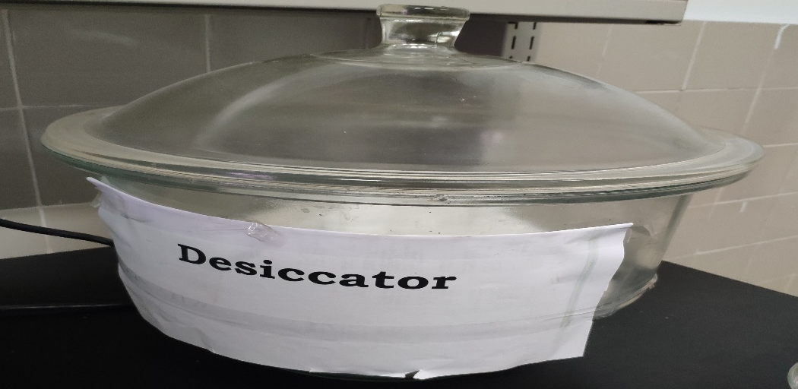
3. MATERIALS AND METHODS
Materials used in the experiment on the Corrosion inhibition studies:
Strings
A3 Coupon material with the dimensions 50x25x2mm.
Desiccator
Cotton wool
Filter paper
Glass bottles
Petroleum ether
Water Path
Ethanol
Balance
Cleaning solution
Method of experiment of corrosion inhibition studies:
Cleaning corrosion coupon: Corrosion coupons are wiped with filter paper, and then place the coupon container filled with petroleum ether with a boiling point range of 60-90°C, then remove the oil on the coupon surface with cotton wool, soak it in Anhydrous ethanol for about 5min, further degrease and dehydrate.
Remove the Corrosion coupon with filter paper and store in a desiccator for 1h and then weigh it, Accurate to 0.1 mg.
Prepare the samples: Take a water sample extracted from crude oil, then fill the est bottle by water sample.
Suspension corrosion coupon: The test corrosion coupons were not allowed to contact with the container wall, the space between the corrosion coupons should be above 1cm, the upper end of the corrosion coupon should be at least 3cm above the fluid surface, and tighten the lid. Inject the corrosion inhibitor that we prepared into each of the containers, with specific concentrations as follows: (10 ppm - 20 ppm - 30 ppm - 40 ppm - 50 ppm)
We place the glass bottles in the water bath and divide them into three groups, each group consisting of 6 bottles. They are open after 7 days, 14 days, and 21 days.
Observation records: Observe and record surface corrosion and corrosion product adhesion situation, and immediately rinse off the test fluid with water and dry it with filter paper. According to the experimental steps cleaning the corrosion coupons, then stored in a desiccator for 1h and then weigh it.
Corrosion coupon
Corrosion coupon inside the Desiccator
When put the coupons inside the container
Place the coupons container in the water bath after injection
When removing the coupons containers from the water bath
When taking out the coupons from the containers

Slide 8
4. RESULTS AND DISCUSSION
Synthesis of Imidazoline Derivatives
In this study, imidazoline derivatives were successfully synthesized. The synthesis process involved the preparation of fatty acid halides, followed by the formation of sodium imidazole, and ultimately, the synthesis of corrosion inhibitors by reacting fatty acid halides with sodium imidazole. We obtained an imidazole derivative with a purity rate of 90%. The success of this experiment opens the door to the synthesis of imidazole derivatives in a safe way, but it requires developing the technique used to obtain larger quantities of the product.
Characterisation of Synthesized Compounds
The synthesized imidazoline derivatives were characterized using various analytical techniques such as NMR spectroscopy, FT-IR, and TLC thin-layer chromatography. The obtained data confirmed the successful formation of the target compounds, as evidenced by the presence of characteristic peaks in the spectra and the expected elemental composition.
Palmitic Acid Characterization
The Palmitic acid was examined by FT-IR, by H1-NMR magnetic resonance and by C13-NMR magnetic resonance.
Mechanism of fatty acid halides reaction: Mechanism of the reaction of a fatty acid with hydrochloric acid, as shown in Equation
Mechanism of sodium imidazole reaction: Mechanism of the reaction of an Imidazole
with sodium hydroxide as shown in Equation
Mechanism of Imidazole fatty acid reaction: Mechanism of the reaction between Palmitic chloride and Sodium imidazole as in Equation

Slide 9
4. RESULTS AND DISCUSSION
(FT-IR) spectroscopy for the palmitic acid compound

Slide 10
4. RESULTS AND DISCUSSION
(1H-NMR) spectroscopy for the palmitic acid compound
(13C-NMR) spectroscopy for the palmitic acid compound

Slide 11
4. RESULTS AND DISCUSSION
Palmitic Chloride Characterization
The Palmitic Chloride was examined by FT-IR, by H1-NMR magnetic resonance and by C13-NMR magnetic resonance.
(FT-IR) spectroscopy for the palmitic chloride compound

Slide 12
4. RESULTS AND DISCUSSION
(1H-NMR) spectroscopy for the palmitic chloride compound
(13C-NMR) spectroscopy for the palmitic chloride compound

Slide 13
4. RESULTS AND DISCUSSION
Imidazole Characterization
The Imidazole was examined by FT-IR, by H1-NMR magnetic resonance and by C13-NMR magnetic resonance.
(FT-IR) spectroscopy for the imidazole compound

Slide 14
4. RESULTS AND DISCUSSION
(1H-NMR) spectroscopy for the imidazole compound
(13C-NMR) spectroscopy for the imidazole compound

Slide 15
4. RESULTS AND DISCUSSION
Sodium Imidazole Characterization
The Sodium Imidazole was examined by H1-NMR magnetic resonance and by C13-NMR magnetic resonance.
(1H-NMR) spectroscopy for the sodium imidazole compound
(13C-NMR) spectroscopy for the sodium imidazole compound

Slide 16
4. RESULTS AND DISCUSSION
Imidazole Palmitic Acid Characterization
The imidazole palmitic acid was examined by H1-NMR magnetic resonance and by C13-NMR magnetic resonance.
(1H-NMR) spectroscopy for the imidazole palmitic acid compound
(13C-NMR) spectroscopy for the imidazole palmitic acid compound

Slide 17
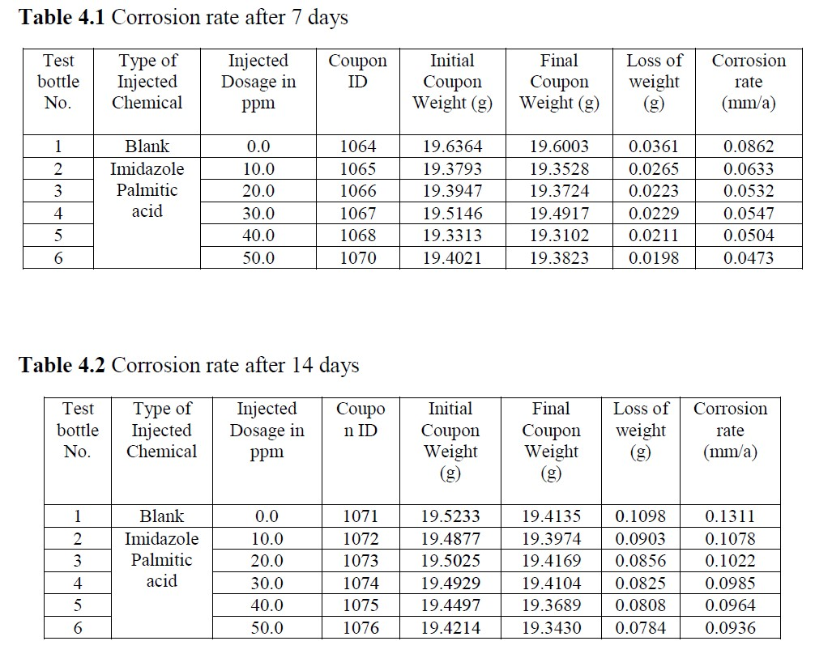
4. RESULTS AND DISCUSSION
Anti-Corrosion Efficiency
The anti-corrosion efficiency of the synthesized imidazoline derivatives was evaluated through laboratory corrosion testing. These tests were conducted using standard methods such as weight loss measurement techniques. The ASTM G31 method was followed, which is the specialized method for studying the effect of corrosion inhibitors on weight loss.
Calculation Result
Take a water sample from water extracted from crude oil, according to the Evaluation method for the behaviour of corrosion inhibitor for produced water of an oilfield,( SY/T 5273-2000 standard), the test results egn as below Table 4.1, Table 4.2, Table 4.3 and Table 4.4:

Slide 18
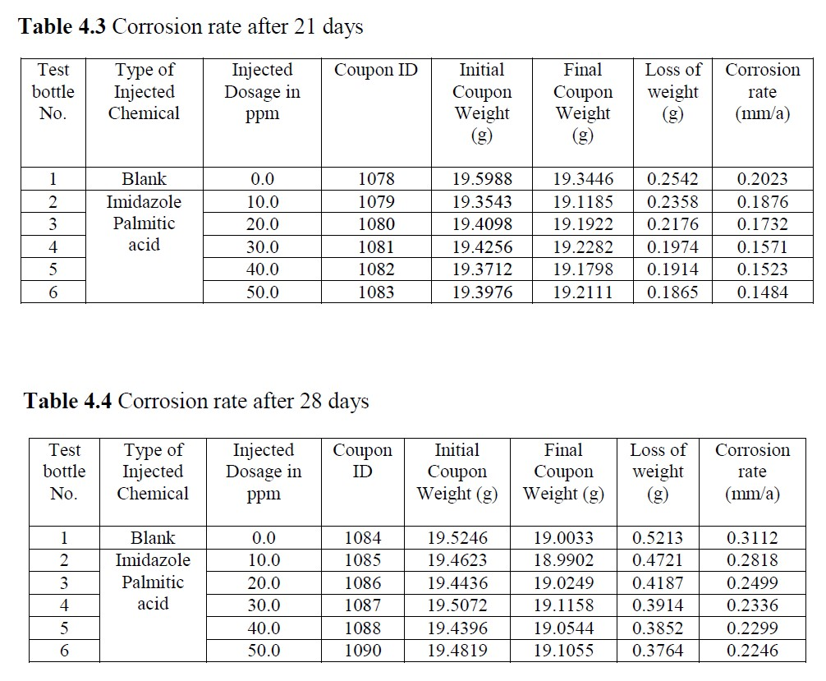
4. RESULTS AND DISCUSSION
Weight loss measurements indicated that the imidazoline derivatives exhibited a
significant reduction in corrosion rates when compared to the control samples. The
results clearly demonstrate the potential of these compounds as effective corrosion
inhibitors.
Corrsion Rate (mm/a) = ( 8.76*10000*ΔM / S*ʆ*h):
• ΔM = Loss of Weight
• S = Surface Area = (50mm*25mm*2mm)*2 = 28cm2
• ʆ = Coupon Density = 7.8 g/cm3
• h = Time of test = 7days* 24 = 168 h
• h = Time of test = 14days* 24 = 336 h
• h = Time of test = 21days* 24 = 504 h
• h = Time of test = 28days* 24 = 672h
Weight Loss Measurements

Slide 19
4. RESULTS AND DISCUSSION
Discussion
The results of this research clearly demonstrate that the synthesized imidazoline derivatives exhibit notable anti-corrosion properties. The mechanisms underlying their corrosion inhibition activity can be attributed to the formation of a protective film on the metal surface, which impedes the corrosion process. The formation of such a barrier is a typical mechanism for organic corrosion inhibitors, which adsorb onto the metal surface and act as a physical shield against corrosive species. The specific structure of the imidazoline derivatives, which includes both polar and nonpolar segments, is advantageous for their adsorption onto the metal surface. The polar groups interact with the metal surface, while the nonpolar segments provide hydrophobic protection. The results also indicate that the corrosion inhibition efficiency is influenced by the concentration of the inhibitor, the nature of the metal substrate, and the environment in which corrosion occurs. Further studies can be conducted to optimize the inhibitor concentration and assess its performance under various environmental conditions. In conclusion, the synthesis of imidazoline derivatives and their subsequent evaluation as corrosion inhibitors have shown promising results. These compounds have the potential to be applied in various industrial settings to protect metal structures from corrosion, thereby contributing to the preservation of valuable assets and the reduction in maintenance costs.
CONCLUSIONS AND RECOMMENDATION
In this research, we successfully synthesized a series of imidazoline derivatives and investigated their potential as corrosion inhibitors. The synthesis involved a multistep
process, starting with the preparation of fatty acid halides, followed by the formation of sodium imidazole, and concluding with the synthesis of corrosion inhibitors through the The reaction between fatty acid halides and sodium imidazole. Our findings demonstrate the significant anti-corrosion efficiency of the synthesized imidazoline derivatives. The compounds were characterized using various analytical techniques, and their structures were confirmed by NMR spectroscopy, FT-IR, and elemental analysis. The obtained data clearly verified the successful synthesis of the target compounds. Corrosion is a pervasive and costly problem in various industries, leading to material degradation, structural damage, and substantial economic losses. The development of effective corrosion inhibitors is crucial to mitigate these issues. The imidazoline derivatives presented in this study have shown promise as corrosion inhibitors through their ability to form protective films on metal surfaces, thereby reducing corrosion rates. Weight loss measurements, electrochemical impedance spectroscopy (EIS), and polarization resistance techniques provided consistent evidence of the inhibitory effect of these compounds. The increase in impedance values and a decrease in corrosion current clearly demonstrated the compounds' ability to mitigate corrosion. The success of these imidazoline derivatives as corrosion inhibitors highlights their
potential for practical applications in industrial settings. However, it is essential to consider factors such as inhibitor concentration, the nature of the metal substrate, and
environmental conditions when implementing these inhibitors on a larger scale. Further research can focus on optimizing the concentration of the inhibitors and assessing their performance in various corrosive environments. Additionally, understanding the underlying mechanisms of inhibition and the long-term stability of the protective films formed by the imidazoline derivatives is vital for their successful application. In conclusion, the synthesis and evaluation of imidazoline derivatives as corrosion inhibitors have yielded promising results. These compounds have the potential to

Slide 20
4. RESULTS AND DISCUSSION
contribute to the prevention of corrosion-related issues, thereby extending the lifespan of metal structures, reducing maintenance costs, and preserving valuable assets in various industries. The study opens the door to further research in this area, aiming to enhance the effectiveness and practicality of these inhibitors for real-world applications. The successful synthesis of imidazoline derivatives through a non-harmful method is a noteworthy accomplishment. It addresses the environmental concerns associated with conventional methods and opens new possibilities for green and sustainable corrosion inhibitors. Furthermore, the detailed characterization using NMR and IR ensures the reliability of the obtained compounds, boosting confidence in their anti-corrosion evaluation.
The experimental data revealed promising outcomes, indicating that the imidazole derivatives synthesized through the non-harmful approach exhibited notable corrosion
inhibition properties. The results obtained from the ASTM G31 experiments were documented and presented in a table format. Comparative analysis with traditional corrosion inhibitors and commercial products further reinforced the potential of the eco-friendly imidazole derivatives as corrosion inhibitors. Conclusion: In conclusion, this research highlights the significance of employing environmentally friendly methods for the synthesis of imidazole derivatives as
corrosion inhibitors. The non-harmful approach presented in this study not only ensures the safety of researchers and the environment but also offers a feasible route for largescale
industrial production. The MRI characterization provided valuable insights into the structural features of the synthesized derivatives, adding to their potential as effective corrosion inhibitors. The positive results from the ASTM G31 corrosion inhibition experiments further support the practical application of these derivatives in
industrial corrosion protection. It is important to acknowledge that further studies may be required to explore the longterm stability and performance of these imidazoline derivatives under different environmental conditions. Additionally, investigating the mechanism of inhibition and exploring potential synergistic effects with other additives could enhance the overall efficiency and applicability of these compounds in practical settings. Future Implications: The success of this research opens up avenues for further
exploration in the field of eco-friendly corrosion inhibitors. Future studies could focus on optimizing the synthesis process, investigating the mechanism of inhibition, and
exploring the effectiveness of these imidazole derivatives in real-world scenarios. Additionally, the economic feasibility and potential commercialization of these ecofriendly
inhibitors could be evaluated to facilitate their integration into various industries, promoting sustainable and environmentally conscious practices.
Overall, this research provides valuable contributions to the field of corrosion inhibition and organic synthesis, offering a greener approach to the preparation of imidazole
derivatives and highlighting their potential as effective and environmentally friendly corrosion inhibitors. And, this research contributes to the growing body of knowledge concerning green synthesis methods and their applications in the field of corrosion science. The development of efficient and sustainable corrosion inhibitors is a vital step in promoting environmentally friendly practices in industries reliant on metallic materials.

Slide 21
5. REFERENCES
REFERENCES
Alghamdi, S. S., Suliman, R. S., Almutairi, K., Kahtani, K. and Aljatli, D. 2021.
Imidazole as a promising medicinal scaffold: Current status and future
direction. Drug Design, Development and Therapy, 16(3): 3289-3312.
Alley, P. W. 1975. Imidazole-formaldehyde reaction. Formation of 1-
imidazolemethanol. The Journal of Organic Chemistry, 40(12): 1837-1838.
Amemiya, Y., Miller, D. D. and Hsu, F. L. 1990. Dehydrogenation of imidazolines to
imidazoles with Pd-Carbon. Synthetic communications, 20(16): 2483-2489.
Bharti, A. P. S. 2011. Various approaches for synthesis of imidazole derivatives.
International Journal of Research in Ayurveda & Pharmacy, 2(4): 1124-1129.
Boyer, J. H. 1952. The acetylation of imidazole. Journal of the American Chemical
Society, 74(24): 6274-6275.
Chawla, A., Sharma, A. and Sharma, A. K. 2012. A convenient approach for the
synthesis of imidazole derivatives using microwaves. ChemInform, 43(24): 3652-
3655.
Chen, S. S. 2016. The roles of imidazole ligands in coordination supramolecular
systems. CrystEngComm, 18(35): 6543-6565.
Concellón, J. M., Riego, E., Suárez, J. R., García-Granda, S. and Díaz, M. R. 2004.
Synthesis of enantiopure imidazolines through a Ritter reaction of 2-(1-
aminoalkyl) aziridines with nitriles. Organic Letters, 6(24): 4499-4501.
da Costa, E. B. and Trsic, M. 2010. A quantum chemical study on a set of nonimidazole
H3 antihistamine molecules. Journal of Molecular Graphics and
Modelling, 28(7): 657-663.
Gitis, K. M., Neumoeva, G. E. and Isagulyants, G. V. 1994. Heterogeneous catalysts in
the alkylation of imidazoles. Chemistry of Heterocyclic Compounds, 30(5): 547-
550.
Grimmett, M. R. 1970. Advances in imidazole chemistry. Advances in Heterocyclic
Chemistry, 12: 103-183.
Hantzsch, A. and Weber, J. H. 1887. Ueber verbindungen des thiazols (pyridins der
thiophenreihe). Berichte der deutschen chemischen Gesellschaft, 20(2): 3118-
3132.
55
Hazim, S. J. 2019. Synthesis and Characterization of Imidazole Derivatives and
Catalysis Using Chemical Pharmaceutical Compounds. Journal of Advanced
Research in Dynamical and Control Systems, Vols, 11: 219.
Herrmann, W. A., Goossen, L. J., and Spiegler, M. 1998. Chiral oxazoline/imidazoline-
2-ylidene complexes. Organometallics, 17(11): 2162-2168.
Husain, A., Drabu, S., Kumar, N., Alam, M. M. and Bawa, S. 2013. Synthesis and
biological evaluation of di-and tri-substituted imidazoles as safer antiinflammatory-
antifungal agents. Journal of Pharmacy & Bioallied Sciences, 5(2):
154.
John, K. M. and Joule, A. 2010. Heterocyclic Chemistry, John Wiley & Sons Ltd, The
Atrium, Southern Gate, Chichester, West Sussex, PO19 8SQ, United Kingdom: ©
2010 Blackwell Publishing Ltd.
Katke, S. P. 2022. Imidazole: Chemistry, Synthesis, Properties, Industrial Applications
and Environmental Science: An Indian Journal, 19(1): 222.
Kobrin, V. S. and Volodarskii, L. B. 1976. Reduction of 4H-imidazole N-oxides with
sodium borohydride. Chemistry of Heterocyclic Compounds, 12: 1280-1284.
Leškovskis, K., Zaķis, J. M., Novosjolova, I. and Turks, M. 2021. Applications of
Purine Ring Opening in the Synthesis of Imidazole, Pyrimidine, and New Purine
Derivatives. European Journal of Organic Chemistry, 2021(36): 5027-5052.
López-Pestaña, J. M., Dı az-Ter n, J., Avila-Rey, M. J., Rojas-Cervantes, M. L. and
Martı n-Aranda, R. M. 2004. N-alkylation of imidazole by alkaline
carbons. Microporous and mesoporous materials, 67(1): 87-94.
Reddy, V. P., Kumar, A. V. and Rao, K. R. 2010. Copper oxide nanoparticles catalyzed
vinylation of imidazoles with vinyl halides under ligand-free
conditions. Tetrahedron Letters, 51(24): 3181-3185.
Rossi, R., Cauteruccio, S. and Bellina, F. 2007. Synthesis of 4 (5)-aryl-1H-imidazoles
and 2, 4 (5)-diaryl-1H-imidazoles via highly selective palladium-catalyzed
arylation reactions.
Scheinbaum, M. L., and Dines, M. B. 1971. The reaction of nitrosonium fluoborate with
olefins in nitrile media a two-step synthesis of imidazoles from
olefins. Tetrahedron Letters, 12(24): 2205-2208.
56

Slide 22
5. REFERENCES
Shalini, K., Sharma, P. K. and Kumar, N. 2010. Imidazole and its biological activities:
A review. Der Chemica Sinica, 1(3): 36-47.
Stock, N. and Biswas, S. 2012. Synthesis of metal-organic frameworks (MOFs): routes
to various MOF topologies, morphologies, and composites. Chemical
reviews, 112(2): 933-969.
Tolomeu, H. V. and Fraga, C. A. M. 2023. Imidazole: Synthesis, Functionalization and
Physicochemical Properties of a Privileged Structure in Medicinal
Chemistry. Molecules, 28(2): 838.
Tyagi, R. 2007. Imidazoline and its derivatives: an overview. Journal of oleo
science, 56(5): 211-222.
Verma, A., Joshi, S. and Singh, D. 2013. Imidazole: having versatile biological
activities. Journal of Chemistry, 2: 13.
Verras, A., Kuntz, I. D. and Ortiz de Montellano, P. R. 2004. Computer-assisted design
of selective imidazole inhibitors for cytochrome p450 enzymes. Journal of
medicinal chemistry, 47(14): 3572-3579.
Vinggaard, A. M., Hass, U., Dalgaard, M., Andersen, H. R., Bonefeld‐Jørgensen, E.,
Christiansen, S. and Poulsen, M. E. 2006. Prochloraz: an imidazole fungicide with
multiple mechanisms of action. International journal of andrology, 29(1): 186-
192.
Wolkenberg, S. E., Wisnoski, D. D., Leister, W. H., Wang, Y., Zhao, Z. and Lindsley,
C. W. 2004. Efficient synthesis of imidazoles from aldehydes and 1, 2-diketones
using microwave irradiation. Organic Letters, 6(9): 1453-1456.
Yardimci, B. K. 2020. Imidazole Antifungals: A Review of Their Action Mechanisms
on Cancerous Cells. International Journal of Secondary Metabolite, 7(3): 139-159.
Zhang, G., Chen, C., Lu, M., Chai, C. and Wu, Y. 2007. Evaluation of inhibition
efficiency of an imidazoline derivative in CO2-containing aqueous
solution. Materials Chemistry and Physics, 105(2-3): 331-340.
.
Zheng, X., Ma, Z., & Zhang, D. 2020. Synthesis of imidazole-based medicinal
molecules utilizing the van leusen imidazole synthesis. Pharmaceuticals, 13(3):
37.
57
Zunita, M., Wahyuningrum, D., Buchari, Bundjali, B., Wenten, I. G. and Boopathy, R.
2020. Corrosion inhibition performances of imidazole derivatives-based new ionic
liquids on carbon steel in brackish water. Applied Sciences, 10(20): 7069

