Slide 1
Correlation between visfatin and hemoglobin A1c in type 2 diabetic patients
Farah ALHADDAD
Prof. Dr. Volkan EYÜPOĞLU

Slide 2
Aım of the RESEARCH
Study the correlation between visfatin and hemoglobin A1c in type 2 diabetic patients

Slide 3
ABSTRACT
Hyperglycemia is the hallmark of type two diabetes mellitus (T2DM), a chronic metabolic disease. It could be because of a lack of insulin production or a resistance to insulin effects on the body. There's a direct correlation between visfatin levels and T2DM, where visfatin is a newly discovered adipocyte hormone. The study included 120 volunteers who attended some hospitals in Salah al-Din/IRAQ, divided into two groups. The first group included 60 patients diagnosed clinically and under periodic monitoring with type two diabetes for more than five years. The second group included 60 volunteers of an age group close to the patients.

Slide 4
ABSTRACT
The descriptive analysis was conducted, and the mean and standard deviation of the parameters was obtained, where the age was (58.721±7.850 years) for the healthy and (59.345±8.150 years) for the patients, where there was no significant difference. Still, the concentration of visfatin in the serum was elevated in the patients versus healthy volunteers, with a significant difference where; the p-value was ≤0.001**. Concerning glycated hemoglobin was elevated in the patients versus healthy volunteers where there was a significant difference, and the p-value was ≤0.001**.

Slide 5
ABSTRACT
Finally, the fasting blood sugar level was elevated in the patients versus healthy volunteers, there was a significant difference, and the p-value was ≤0.001**. Visfatin was positively correlated with HbA1c, where the values of r = 0.3510** and p = 0.0060. In addition, there was no correlation between visfatin and fasting blood sugar, as the values of r = 0.7710 and p = 0.0380. Correlation is considered significant at the 0.01 level (2-tailed). In conclusion, visfatin was positively correlated with HbA1c and no correlation with fasting blood sugar in patients with T2DM as per the statistical analysis.

Slide 6
Materıal&Methods
Samples
120 samples from control and patients with T2DM were divided into the following categories:
60 healthy control
Kit and Origin
Visfatin ELISA kits from BT LAB, CHINA.
Testing techniques
Enzyme-Linked Immunosorbent Assay (ELISA), for Visfatin.
60 T2DM
Fluorescence based POCT immunoassay technique, for HbA1c.
Visible spectrophotometric technique, for S. Glucose.
Statistical Analysis
S. Glucose, from AGAPPE/Spain.
HbA1c from BODITCH/S. Korea.
It is important to evaluate analytic results in terms of how accurate they are in terms of their sensitivity and specificity and positive and negative predictive values. Mean, and standard deviation are two statistical concepts used to describe analysis results. Mann-Whitney tests are used to compare groups that are abnormally distributed. To be considered statistically significant, the P-value had to be less than 0.01. SPSS 20.0 was used to review and approve all results (SPSS Inc, Chicago, Illinois, USA).

Slide 7
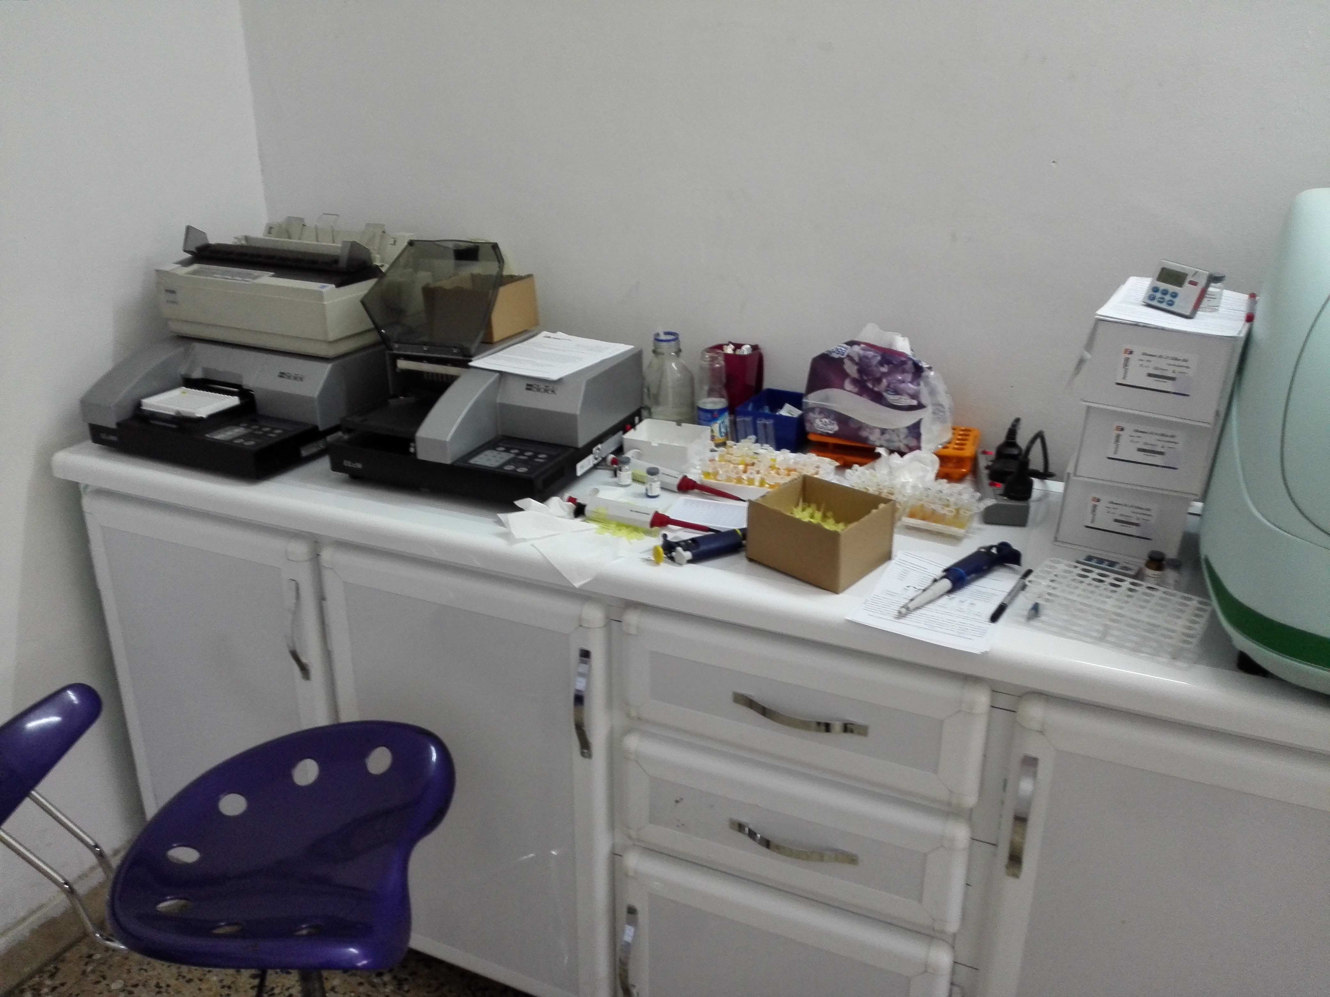
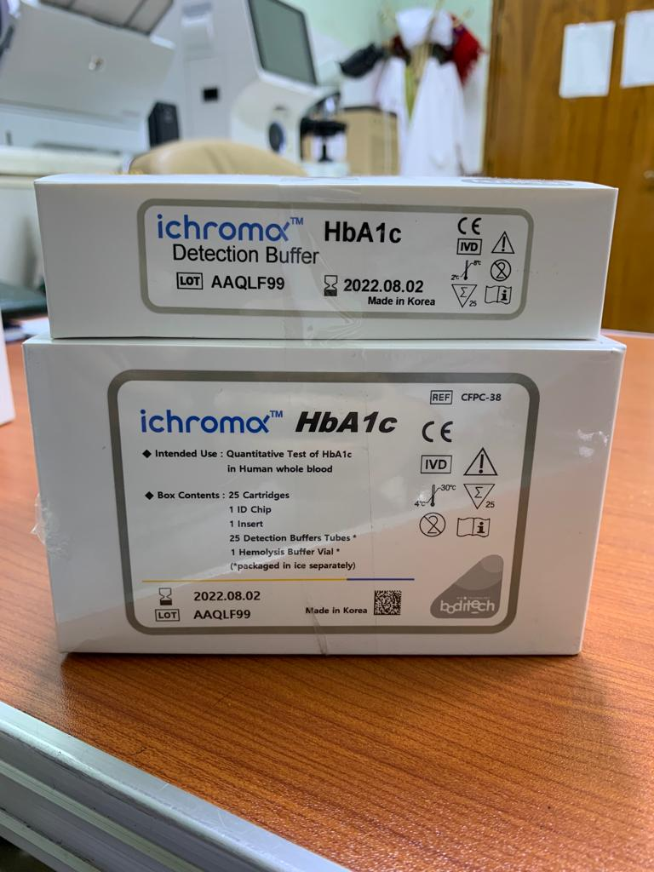

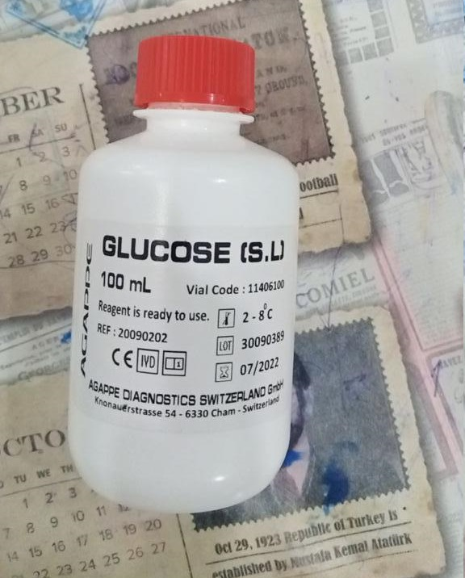
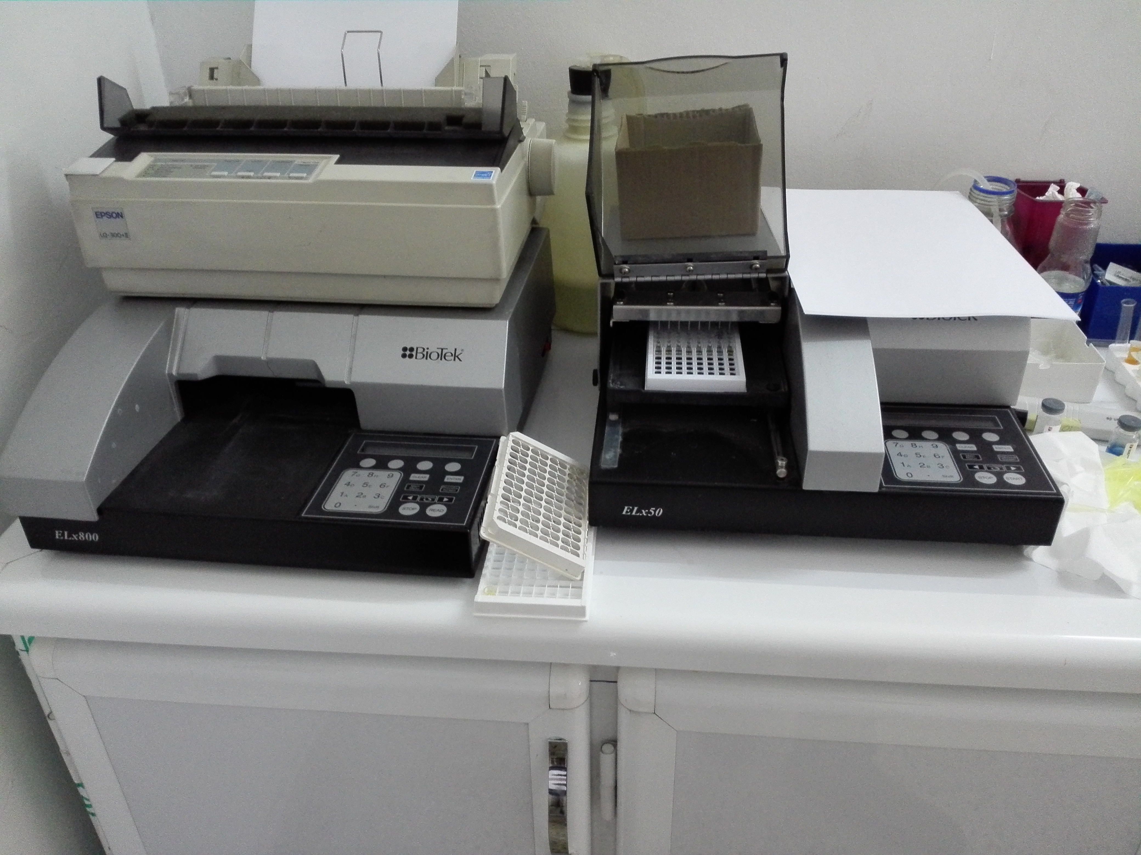
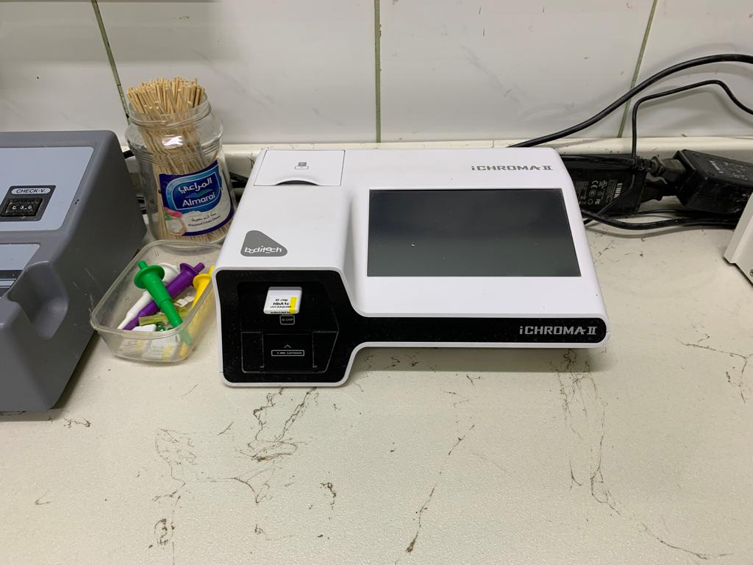
Materıal&Methods
Instruments
&
Kits

Slide 8
Results&dıscussıons
Concerning the results, a questionnaire was conducted for all volunteers in the study, where information was collected about the age and medical history of the participants, and tests for visfatin, glycated hemoglobin, and fasting blood sugar were conducted. The descriptive analysis was conducted, and the mean and standard deviation of the parameters was obtained, where the age was (58.721±7.850 years) for the healthy and (59.345±8.150 years) for the patients, where there was no significant difference, but the concentration of visfatin in the serum was (0.781±0.141 ng/mL) for the healthy and (2.935±0.415 ng/mL) for patients where there was a significant difference, and the p-value was ≤0.001**, concerning glycated hemoglobin it was (5.150±0.350 %) for the healthy and 7.650±0.430 %) for the patients where there was a significant difference, and the p-value was ≤0.001**; finally, the fasting blood sugar level was (88.500±6.150 mg/dL) For healthy subjects and (160.300±5.550 mg/dL) for patients, there was a significant difference, and the p-value was ≤0.001**.

Slide 9
Results&dıscussıons

Slide 10
Results&dıscussıons

Slide 11
Results&dıscussıons
Correlation
When conducting a statistical analysis of the correlation between visfatin, HbA1c, and fasting blood sugar, it was found that visfatin was negatively correlated with HbA1c, where the values of r = -0.3510** and p = 0.0060. In addition, there was no correlation between visfatin and fasting blood sugar, as the values of r = 0.7710 and p = -0.0380. Correlation is considered significant at the 0.01 level (2-tailed), as per table (2).

Slide 12
Results&dıscussıons
Higher concentrations of visfatin, HbA1c, and FBS were found in the blood of those with type 2 diabetes. Visfatin appears to have lost its insulin-like hypoglycemic effect in people with type 2 diabetes, as seen by the patients' raised blood sugar levels. T2DM's etiology and progression could be influenced by this. T2DM and visfatin levels appear to be linked, despite the lack of thorough understanding of this relationship. Visfatin's role in T2DM pathophysiology and development will be clarified with the help of these findings.

Slide 13
Results&dıscussıons
Our study showed that there is no statistical correlation between the level of visfatin and fasting blood sugar for patients. In contrast, a research conducted on humans has showed that the amount of visfatin drops after a period of overfeeding for seven days that is greater than seventy percent of the typical dietary requirements. These findings were found in recent investigations. This suggests that visfatin is not likely involved in the regulation of the glucose metabolic process [8]. It is not clear what caused these differences in opinion or judgment. It is likely that the population that was tested had superior glucose regulation, or that the time frame that was used was not long enough to generate a significant increase in the level of visfatin.

Slide 14
Results&dıscussıons
Visfatin, which regulates glucose levels in a manner analogous to insulin, helps to maintain a consistent glucose level in the blood [3]. From the above facts and it is well known, the increase in blood sugar level in patients with type 2 diabetes, due to lack of insulin or lack of secretion and the response of the pancreas to the increase in circulating blood sugar, and since visfatin plays a mimicry role for insulin, it is natural that its concentration in the blood increases in response to the increase in the level of sugar in the blood. T2DM patients' plasma visfatin levels are likewise elevated by hyperglycemia, which worsens as blood glucose levels rise. A considerable rise in plasma visfatin levels was seen in healthy individuals when levels of glucose were 8.3 mmol/l or higher. Beta cell death has also been linked to a rise in plasma visfatin. Since the patients in this study have type 2 diabetes, it is normal to note that glycated hemoglobin levels are higher and higher than normal in healthy individuals. In a study conducted in 2012 on patients with type 2 diabetes, visfatin levels were determined, which were found to be high compared to healthy people and gave a positive correlation with glycated hemoglobin, and this is the same as what our study led to and also explains the insulin-like behavior of visfatin.

Slide 15
Conclusıons
Higher concentrations of visfatin, HbA1c, and FBS were found in the blood of those with type 2 diabetes. Visfatin Visfatin was positively correlated with HbA1c and no correlation with fasting blood sugar in patients with T2DM as per the statistical analysis..

Slide 16
THANKS FOR YOUR PARTICIPATION AND PATIENCE
The End

